Slide 1
Overview
Invitation
Accept
and review
Further communication
Update your information

Slide 2


Overview
Invitation
Accept and review
How to review
Download and review
Completion
Further communication
Update your information
Peer review overview
Technical and similarity check,
Editor assignment
7 days
We have adopted a single anonymized peer-review process, which means that reviewer identity is not made visible to authors, author identity is visible to reviewers, reviewer and author identity are visible to the editors.
Reviewers are asked to supply confidential comments and recommendations, which will only be visible to the Section Editor and Editor in Chief, and comments for the authors which are shared in an anonymous way.
Reviewer reports are confidential and are not posted with the articles.
Peer review details:
Identity transparency: single anonymized
Reviewer interacts with: Editor in Chief and Section Editors
Review information published: none
Submission
Editorial evaluation
Peer review
Time to reply:
7 days
Reviewer invitation
TARGET
Submission to 1st decision
4-6 ks
Time to submit: 30 days
Recommendation

Slide 3
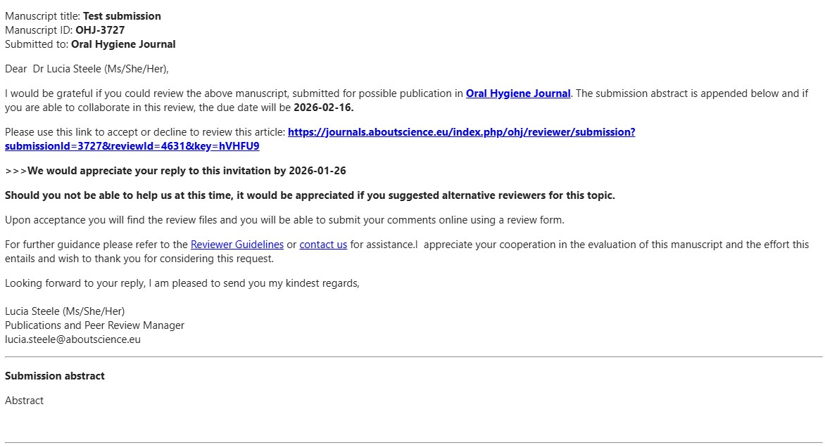
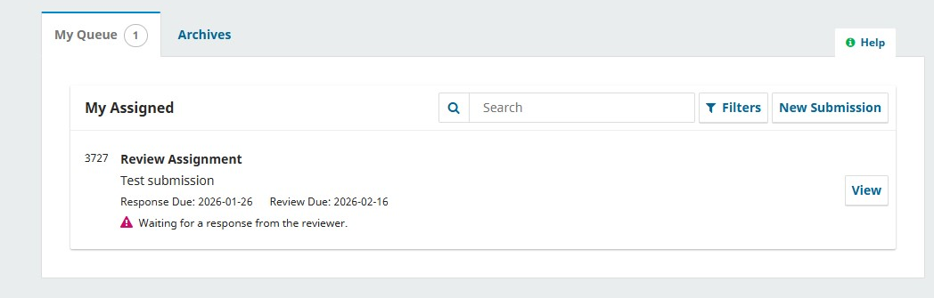
3
Accept and review
How to review
Download and review
Further communication
Update your information
Overview
Invitation
Completion
Invitation
When an Editor invite you to review a manuscript, you will receive an email in your inbox. This email may also land in your spam folder, so please check this as well.
The email will contain the abstract, a link to the submission and an indication of the associated deadlines: the editor may change the deadlines upon invitation.
To respond to an invitation, click on the link provided.
You may also access the submission invitation logging in with your username and password to
www.oralhygienejournal.com

Slide 4
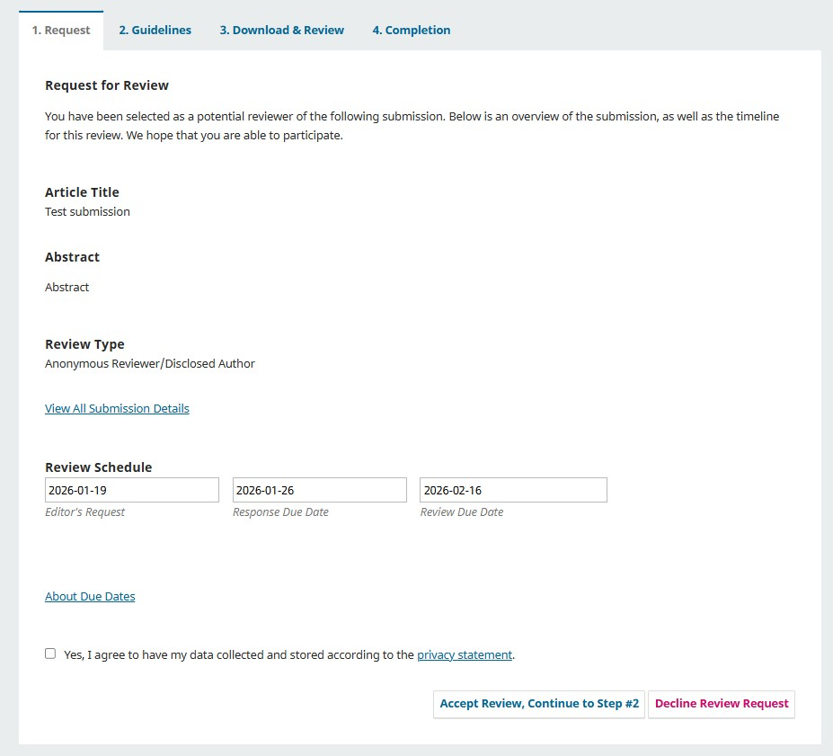
4
Accept and review
How to review
Download and review
Further communication
Update your information
Overview
Invitation
Completion
Accept and review
The Request tab will outline the revision’s relevant dates and will enable you to respond to the invitation.
You will need to agree to the privacy statement in order to proceed.
Click “Accept Review” to continue.
If you cannot accept the invitation, click on “Decline Review Request” where you will find space to communicate with the Editor and possibly suggest alternative reviewers.

Slide 5
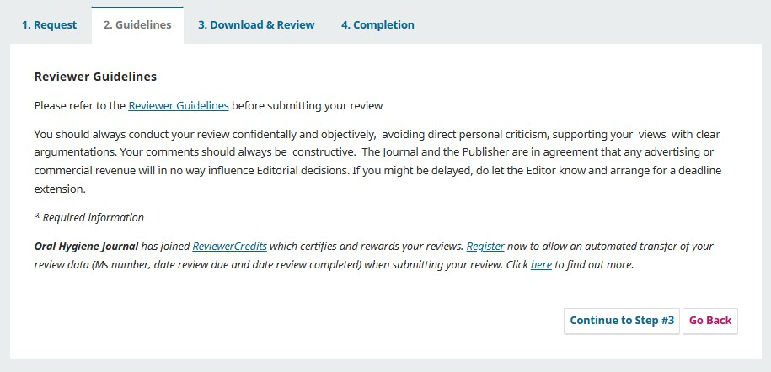
5
Accept and review
How to review
Download and review
Further communication
Update your information
Overview
Invitation
Completion
How to Review
The Guidelines tab will present the journal’s guidelines.
Should you need additional information please contact us anytime:
Email: editorial@aboutscience.eu

Slide 6
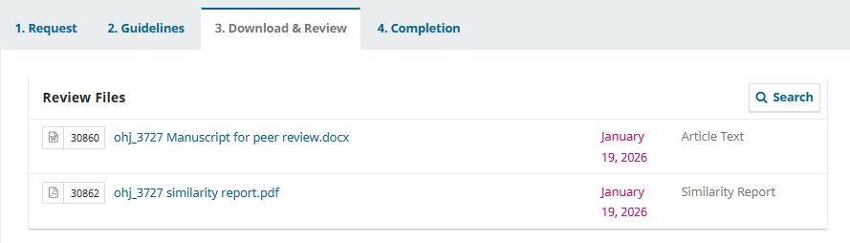
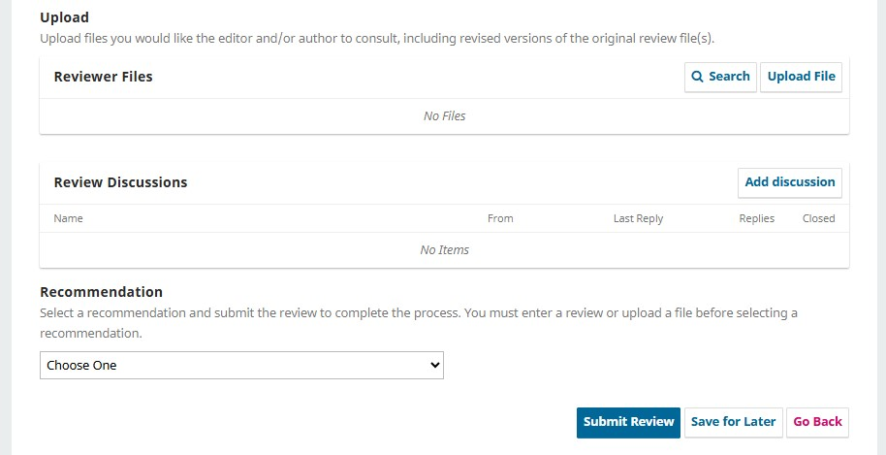
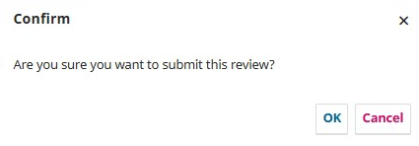
6
Accept and review
How to review
Download and review
Further communication
Update your information
Overview
Invitation
Completion
Download and review
The Download & Review tab will enable you to download all review files and will present the review form to use to submit your comments. You will find a manuscript for peer review file, a similarity report and additional files relevant to the peer review process.
The review form consists of
Rating card
Comments to Authors
Confidential comments to Editor
Space for optional review comments
Your recommendation
Enter comment to the authors and confidential comments for the Editor in the appropriate space provided. Comments for the authors will be included in the decision letter. You may like to upload a file for reviewers, although we recommend that you list your comments in the box provided.
You will be presented with a final confirmation before submitting your review to the journal. Once you have submitted your review, you can no longer make any changes.

Slide 7
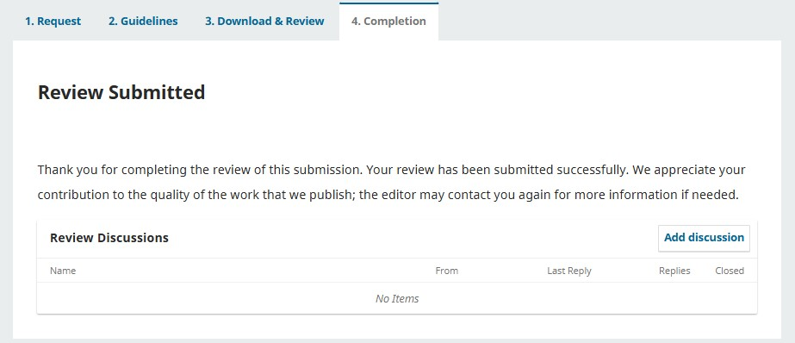
7
Accept and review
How to review
Download and review
Further communication
Update your information
Overview
Invitation
Completion
Completion
The tab Completion is a final confirmation screen you will be presented once you have submitted your review. At this point you can no longer make any changes to your comments.
Should you need to share additional information with the journal at this point, use the button “Add discussion”.

Slide 8
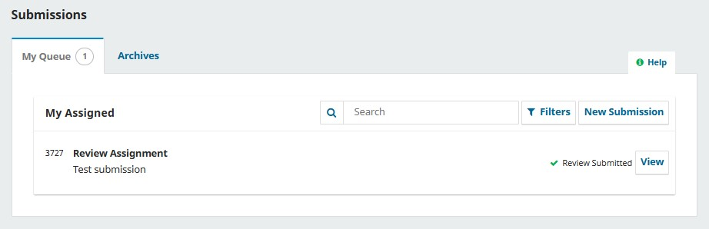
8
Accept and review
How to review
Download and review
Further communication
Update your information
Overview
Invitation
Completion
Further communication
In case you wish to contact the Editor with regards to the submission you have completed, you may access it from your main screen.
Identify the submission either in “My Queue” or in “Archives” and click on View.
You will then access your reviewer comments and the “Add discussion” button.
A submission will be in the “Archive” tab once a final decision has been made.

Slide 9
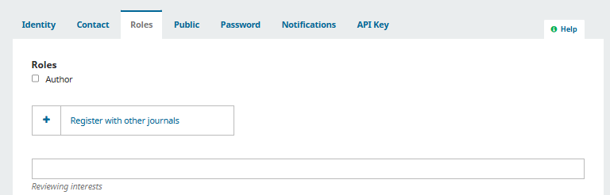
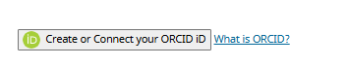
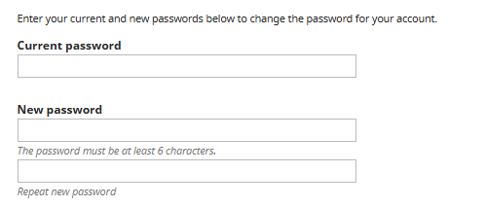
9
Accept and review
How to review
Download and review
Further communication
Update your information
Overview
Invitation
Completion
Further communication
In order to receive invitations to review pertinent to your area of interest, we recommend that you complete your information in your profile. From the upper right corner choose “Edit profile”: choosing the different tabs, you can update your personal details, contact information, update your password and enter or complete your reviewing interests.
IMPORTANT!
Enter your reviewing interests. Please also enter the main section your would like to be involved with as a reviewer
In the “public” tab, please enter your ORCID: this will ensure that your peer review activities is correctly recorded and connected where possible.
When you are registered in the system you will receive a system password, which you may change anytime in the “Password” tab.

